Slide 1
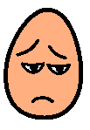
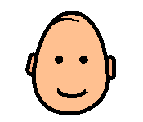
How was my behaviour today?
How was my behaviour today?
(2pts) (no pts) (1pt)
(2pts) (no pts) (1pt)
Attempt set task:
Stay in classroom:
Kind to others:
Attempt set task:
Stay in classroom:
Kind to others:
How was my behaviour today?
How was my behaviour today?
(2pts) (no pts) (1pt)
(2pts) (no pts) (1pt)
Attempt set task:
Stay in classroom:
Kind to others:
Attempt set task:
Stay in classroom:
Kind to others:

