Slide 1
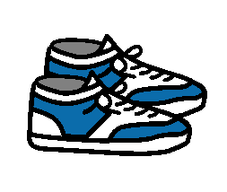
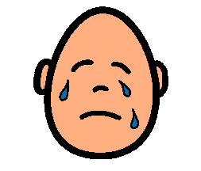
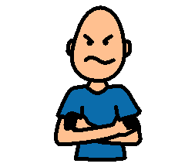
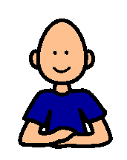
IT’S OKAY
Sometimes at school my friends’ coats are not zipped up. It’s okay.
Sometimes at school my friends’ shoes are off. It’s okay.
Sometimes at school my friends cry. It’s okay.
Sometimes at school my teacher sounds angry. It’s okay.
If I feel upset, I can stop and calm down.

