Slide 1
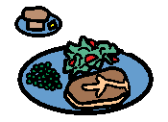
Last night at home
DATE_____________
With ___________________________________________________________
I played ________________________________________________________
I watched ______________________________________________________
________________________________________________________on TV.
I went __________________________________________________________
I had __________________________________________________________
_____________________________________________________for dinner.
I went to bed at ________________________________________________

