Slide 1
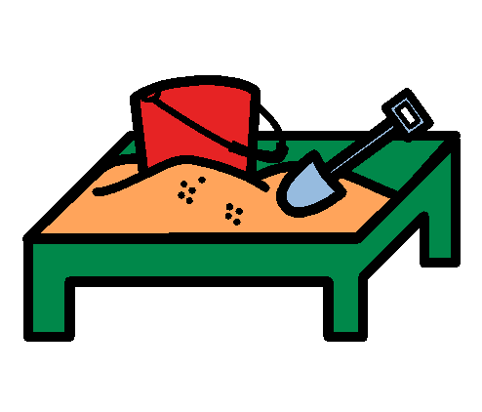
Playing the Sandpit

Slide 2
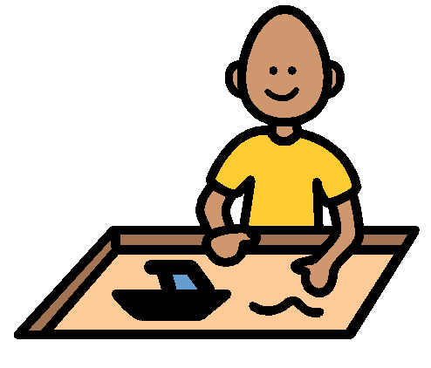
At lunch, I can play in the sandpit.

Slide 3
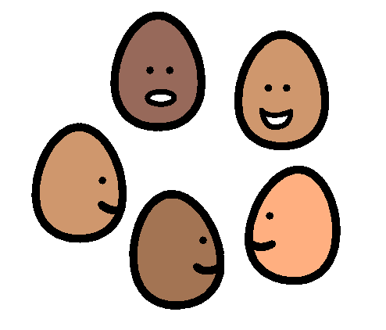
In the sandpit there are lots of children. I find a space to play. I do not get too close.

Slide 4
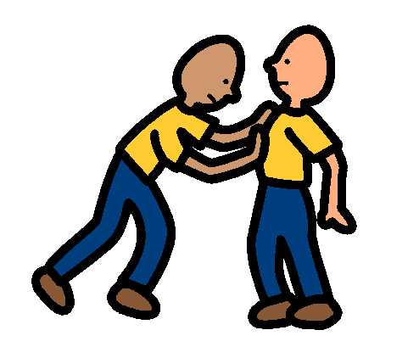
I will play kindly in the sandpit. Pushing children hurts them. I don’t push children. I will keep my hands and feet to myself.

Slide 5
I will play kindly in the sandpit. Poking children hurts them. I don’t poke children. I will keep my hands and feet to myself.

Slide 6
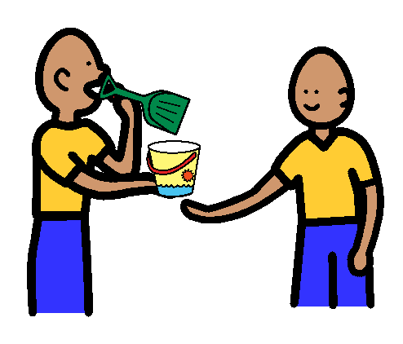
I will take turns and share the sandpit toys. Sharing allows everyone to have a turn. That is fair.

Slide 7
I am happy when I keep my hands and feet to myself.

Slide 8
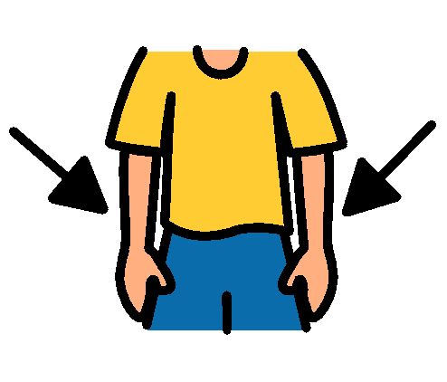
My friends are happy when I keep my hands and feet to myself.

Slide 9
Mrs ????? is happy when I keep my hands and feet to myself.

Slide 10
My Mum and Dad are proud of me when I keep my hands and feet to myself.

Slide 11
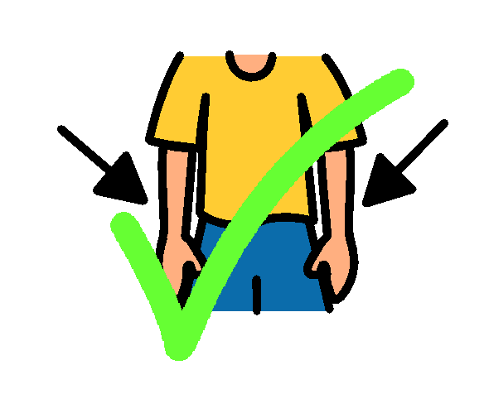
Keeping my hands and feet to myself is playing kindly.

