Slide 1
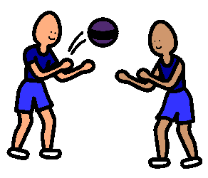
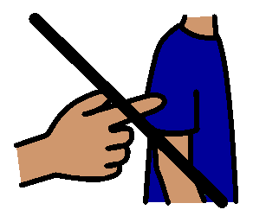
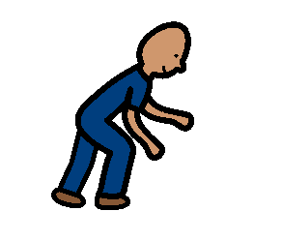
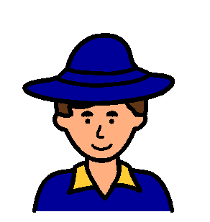
PLAYTIMES
I like to be safe and happy when I play at school.
I keep my hands and feet to myself.
If something is not mine I don’t touch it.
I don’t pick up sticks or stones.
I wear my hat.
When I do all this everyone is safe and happy.

