Slide 1
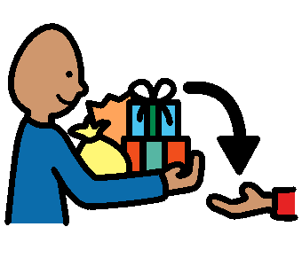
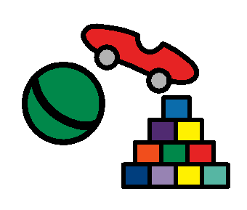
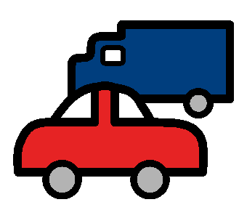
Sharing Story
Sometimes people have things that do not belong to me. They have toys that they like to play with.

Slide 2
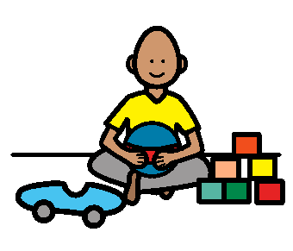
Can I please play with that?
When I see people playing with their toys I can use my inside voice to ask, “Can I please play with that?” If they say “yes” or “okay”, I can play with it. They might say “no”. That means I cannot play with it.
Can I please play with that?
If someone is working with crayons or reading a book, I can ask if I can share with them. I can use my inside voice to say, “Can I please share with you?” Sometimes people will let me use their things if I ask nicely. Sometimes they may need to use it so I will have to wait.

Slide 3
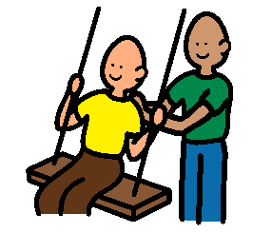
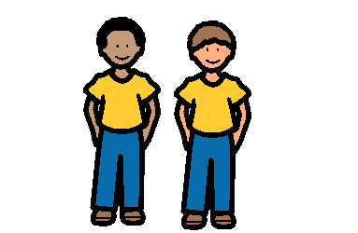
Can I please have a turn?
Someone else may be using outside toys when I go to the playground. I will ask, “Can I please have a turn?” People like it when I ask nicely to take turns.
People like it when I ask before using something. I can get along well with others when I ask before using their things. Friends like it when I ask to share their things.

