Slide 1
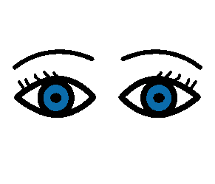
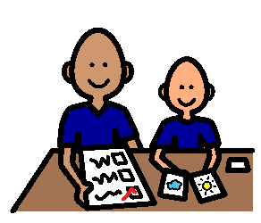
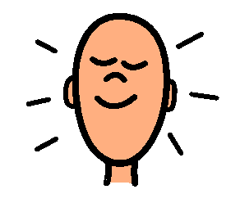
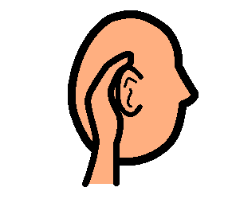




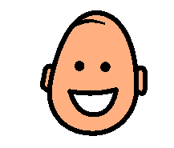
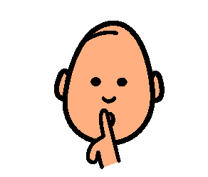
STAYING ON TASK
I do the best job when I try really hard. Then everyone is proud of me.
When I try really hard I am able to stay on task
I stay on task by:
LOOKING
LISTENING
THINKING
BEING QUIET
AND SITTING STILL
When I stay on task I do great work!

