Slide 1
TENNIS COURT RULES
1
Keep our hands and feet to ourselves.
2
Do not spit when you are on the tennis court.
3
If you hit outside the white lines you are out.

Slide 2
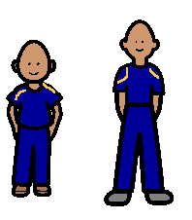
4
Hitting into or under the net is out.
Change places with the person who is waiting when you are out.
5
6
Tennis equipment needs to be used the right way.

Slide 3
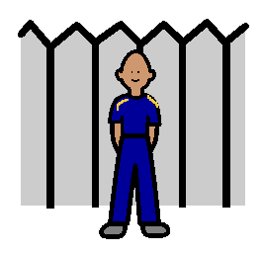
7
If you are waiting you need to stand beside the fence.

