Slide 1
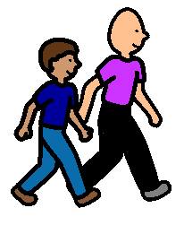
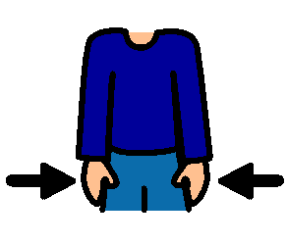
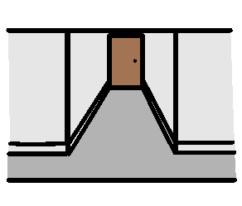
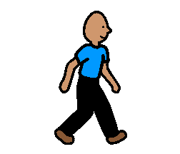
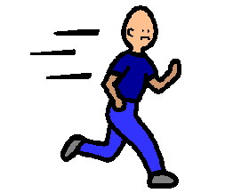
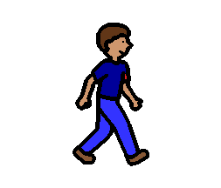
WE NEED TO WALK CALMLY IN THE SCHOOL
WE NEED TO WALK CALMLY IN THE SCHOOL
When I am walking in the school I will stay beside an adult.
My hands will be at my sides.
I will take one step at a time. I will not skip or run.
When I am walking in the school my voice will be quiet.
Everyone should walk calmly in the school.

