Slide 1
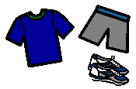
What I Need For School Tomorrow
Other

