Slide 1
CLIP-A-LONG
Imagine you are a paper clip...........
Tell about an adventure you might have.
ICE-IT
Imagine you are an ice cube.......
Tell what might happen to you in one day.

Slide 2
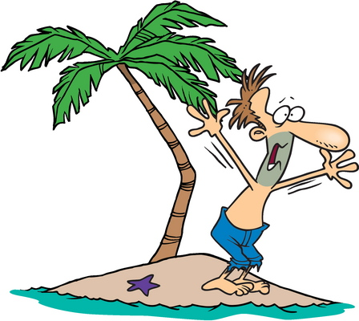
SHIP-WRECKED!
You are alone on an island.....You have an umbrella..... Write down all the ways it can be useful to you.
Draw a picture showing one use of the umbrella.
Draw a rainbow using as many colours as you can.
Write the names of the colours in a column... Next to each colour write the name of something that you think would look good in that colour.
OVER THE RAINBOW

Slide 3
AMIGO
Name your best friend.
Tell all the things you like about him (or her).
Tell about anything you do not like.
MAKE-A-WISH
If you could have any wish, what would it be?
What would you do after the wish came true?

Slide 4
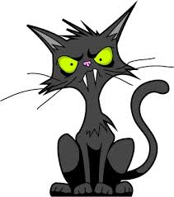
SUPER CHOICE
What unusual pet would you like to have?
Tell why you chose it and what you would do with it.
Draw a picture of your pet.
FOR THE BIRDS
Suppose you had to live in a tree house for three days.
Make a list of all the supplies you would need.

Slide 5
WHO’S THERE?
Finish this story.....
My dog was barking at the front door. We heard a scratching sound outside......
ANTHILL 101
You have just become an ant.
In what ways is your life now different? (Think of housing, food, safety, etc.)

Slide 6
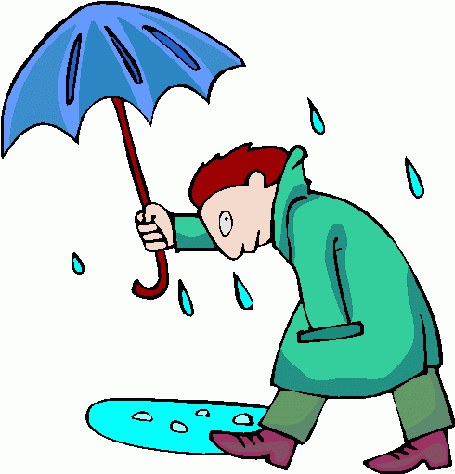
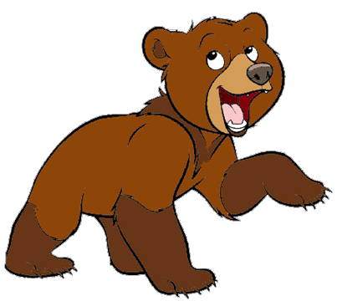
CATS ‘N DOGS
Write a short story that uses these words:
storm, house, rain, fireplace, lightning, soup, log, smoke.
BEAR WITH ME
Write a story that ends with this sentence:
The bear shook my hand and went back into his cage.

Slide 7
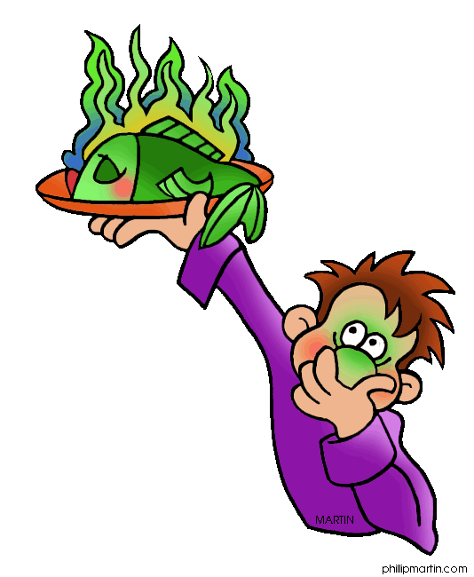
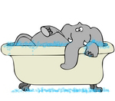
WHIFF-A-BIT
Make a list of 5 smells that you like....and 3 that you do not like.
Draw a picture of something that smells good.
CALL A PLUMBER
What would you do if you found an elephant in your bathtub?
Tell how you might try to get him out.

Slide 8
SOUND OFF
Make a list of eight sounds. Next to each write the thing that makes the sound.
Examples: ring - doorbell
Tick, tock - clock
Name 3 things you like to touch.
Name 3 things you like to hear.
Name 3 things you like to taste.
Draw a picture of something you like to taste.
SENSE-IT

Slide 9
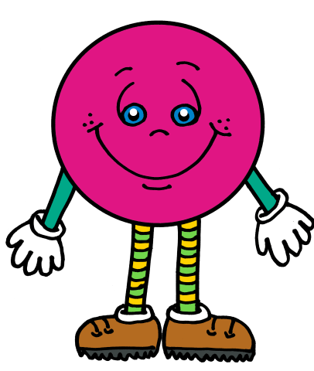
ROSES ARE RED
Imagine you are a rose.
Tell what happens to you from the time you are “born”.
Draw a picture of the happiest time of your life.
SHAPE-UP
Write the names of 5 things around the house that are shaped like a circle; list 5 things that are shaped like a rectangle.

Slide 10
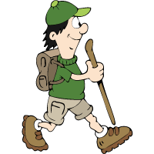
HORNET’S NEST
Tell about the last time you were angry.
What made you angry?
What did you do about it?
What other things may make you angry?
Finish this story:
One day, while walking in the forest, it began to rain...........
(Think of such things as keeping dry, mud, lightening, thunder, wet leaves, odours.)
TALE OF THE WOODS

Slide 11
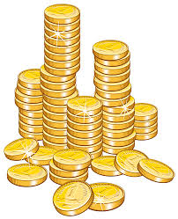
PENNY-WISE
Tell about a secret trip you could take if you were able to be as small as a coin.
Finish these sentences:
He’s as slow as ______________________________
It’s as bright as _____________________________
It’s as cold as _______________________________
It’s as sharp as ______________________________
He’s as tall as ________________________________
It’s as wet as ________________________________
He’s as fast as _______________________________
He’s as noisy as ______________________________
MAKE A COMPARISON

Slide 12
LOOK AROUND
List 5 things you like to look at; and 3 things you do NOT like to look at.
Draw a picture of something that looks good to you.
LAUGHING TV
Think of something funny you saw on television.
Tell what happened and why you think it was funny.

Slide 13
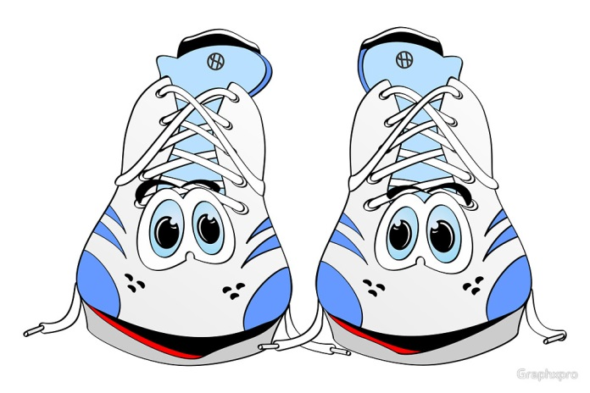
IT’S SHOE TIME
Suppose your shoes could talk.
Make a list of all the things they might tell you.
Imagine you are on water skis. Tell how it feels.
(Think of the speed, the water, your balance.)
What finally happens to you?
SKI TIME

Slide 14
A FISH STORY
Write how you would feel being a fish in an aquarium.
Draw a picture of yourself as the fish you would like to be.
SUNDOWN
Write about a beautiful sunset you saw. Think about all the things in the scene.....the light....shadows .....sky.....clouds.
Draw a picture of the scene as you remember it.

Slide 15
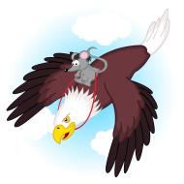
Herman, a cat, is whispering in the ear of George, another a cat. What do you think Herman is saying? What do you think George will say? Write an entire conversation between them.
KIT AND CABOODLE
BIRDS EYE VIEW
Imagine you are on top of a giant eagle flying high in the sky.
Describe how you feel and what you can see.

Slide 16
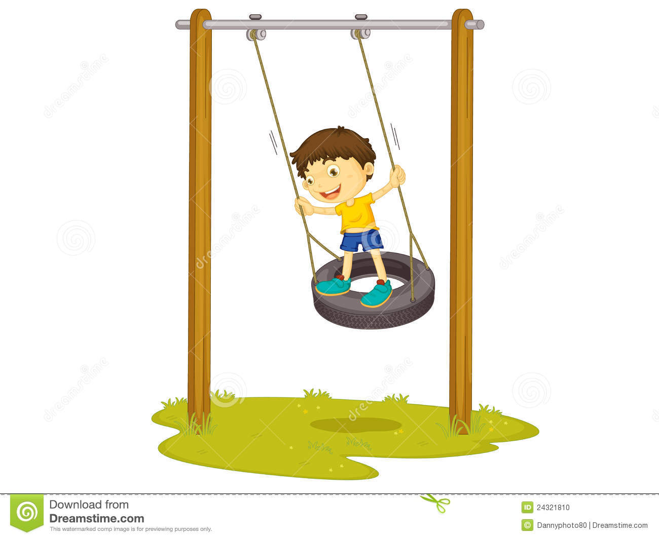
BLOW OUT
What can you do with an old tire from a car?
List at least 5 ways you could put it to use.
You want to sell your bicycle. Write a good ad for the newspaper.
Remember: Give all the important information in an interesting way so that someone will want to buy it.
FOR SALE

Slide 17
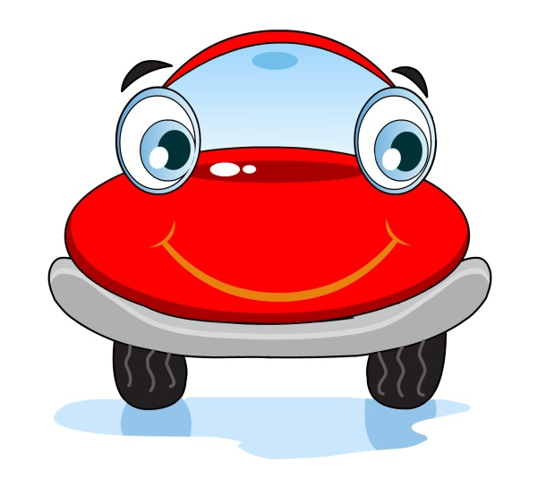
SPREAD THE WORD
You want to tell people about your ideas.
Design 5 bumper stickers with some smart saying on each.
TO THE CHIEF
Write a letter to the president of the United States.
Tell him about the important things for he should be doing for the country.

Slide 18
SIGN HERE
Draw a picture of an outdoor advertising sign to tell about your favourite thing. Include a picture in your sign.
What do you think of the idea of removing all outdoor signs along the highways? Why do you think so?
Describe an elephant to someone who has NEVER seen one, not even a picture.
Remember to think of his size, weight, shape and other important features.
IVORY HUNTER

Slide 19
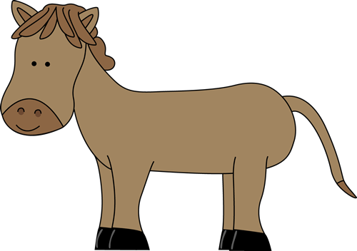
FOUR SEASONS
Write the names of three things that are part of each season of the year. Spring......Summer......Autumn..... Fall......
Examples: Winter-snow; Spring-new leaves.
CHANGE OVER
If you could change into an animal, what would you like to be?
What are all the things you would do?

Slide 20
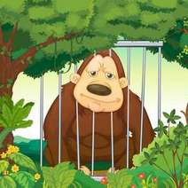
ZOO STUFF
You see a monkey in a cage at a zoo. He looks at you. What do you think he might be thinking.
Tell about an adventure you would like to have with him.
THINGS I SEE
Make a list of six living things you see on the way to school.
Make a list of ten non-living things you see.

Slide 21
SMILE
Imagine you are a toothbrush.
Tell about all the things that could happen to you in one day..
THE BIG TOP
Describe the funniest thing you saw at the circus.
Describe the scariest thing you saw at the circus.

